Slide 1
Phishing Awareness
w.M. Chandu DISSANAYAKE
CA/S3/6378

Slide 2
Agenda
Introduction to Phishing
Types of Phishing Attacks
Examples for Phishing Attack Types
How Phishing Works
Common Signs of Phishing Emails
Consequences of Falling for Phishing
How to Protect Ourself from Phishing
Exploration about Phishing Attacks
Findings from Exploration
Real World Phishing Attack Scenarios
Conclusion

Slide 3
INTRODUCTION
TO
PHISHING

Slide 4
Phishing is a cyber attack where attackers impersonate legitimate entities, typically through fraudulent emails or websites, to trick individuals into revealing sensitive information like passwords, financial details, or personal data for malicious purposes.

Slide 5
TYPES OF PHISHING ATTACKS
Email Phishing: Most common type, involving fraudulent emails.
Spear Phishing: Targeted at specific individuals or organizations.
Whaling: Phishing attacks on high-profile individuals like executives.
Smishing: Phishing via SMS or text messages.
Vishing: Phishing via voice calls.
Angler Phishing: Phishing targets victims via social media platforms.

Slide 6
EXAMPLES
FOR PHISHING ATTACK TYPES

Slide 7
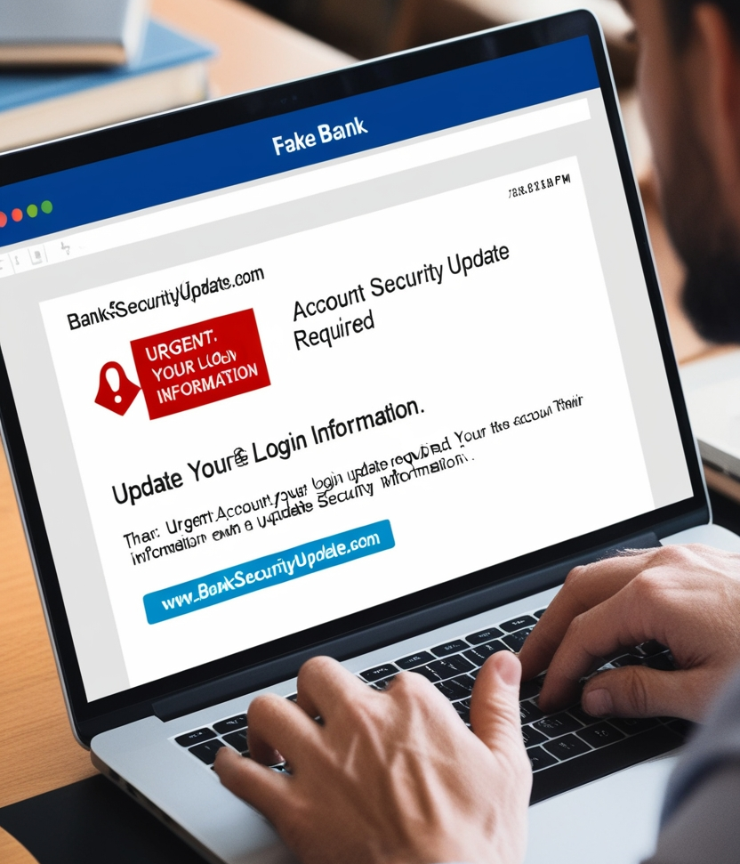
Email Phishing
As an example for this phishing type, imagine we receive an email claiming to be from our bank, asking us to click a link and update our password. The link leads to a fake website that steals your login information.

Slide 8
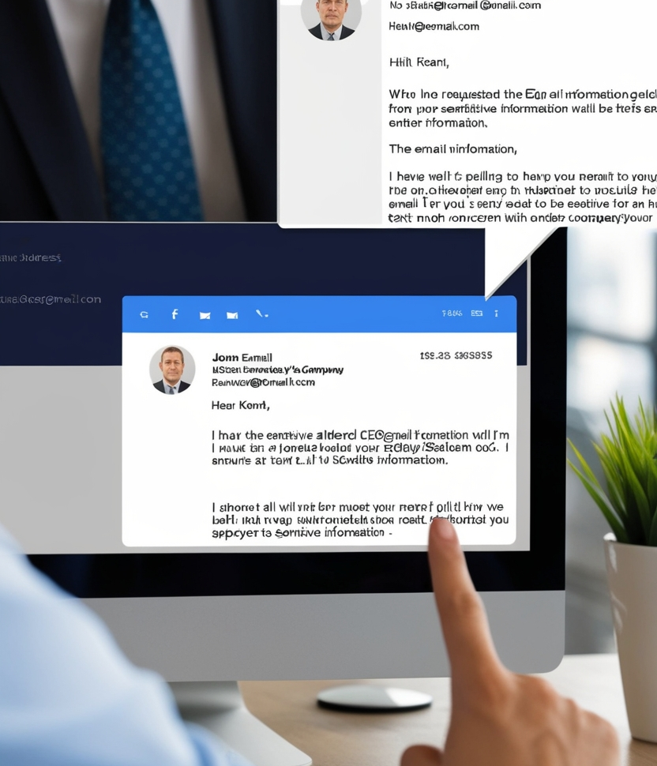
Spear Phishing
As an example for this phishing type, imagine an employee gets an email from what seems to be their boss, asking for sensitive company information. The email looks legitimate but is actually from a hacker targeting the specific employee.

Slide 9

WHALING
As an example for this phishing type, imagine a CEO receives an email that looks like it's from the company’s lawyer, asking for confidential business documents. The attacker specifically targets high-level executives with this approach.

Slide 10
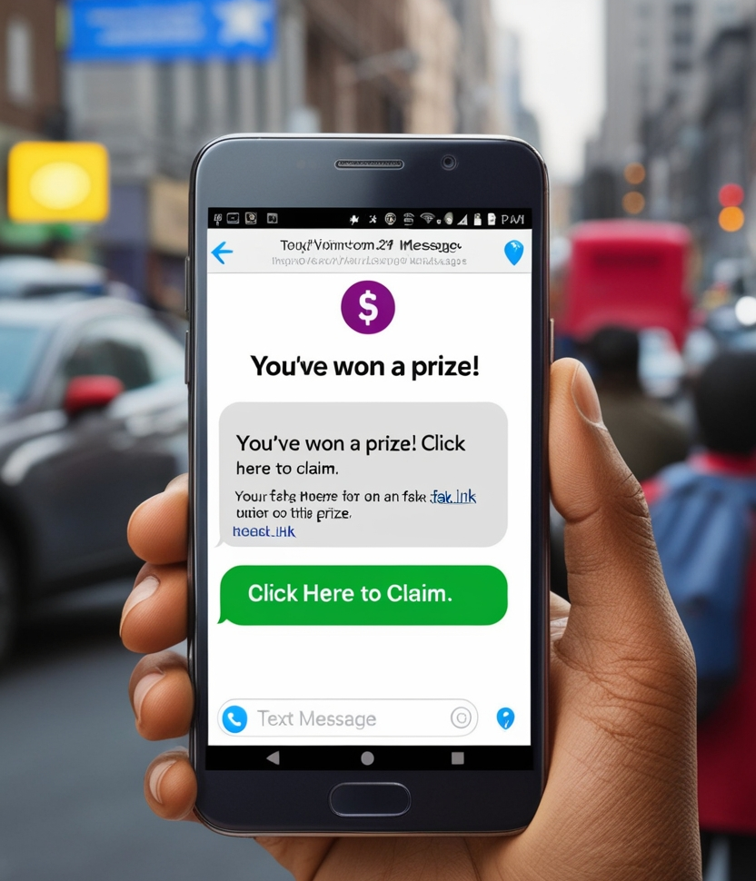
Smishing
As an example for this phishing type, imagine that we get a text message saying you've won a prize and need to click a link to claim it. The link leads to a site that asks for personal information, which the attacker then steals.

Slide 11
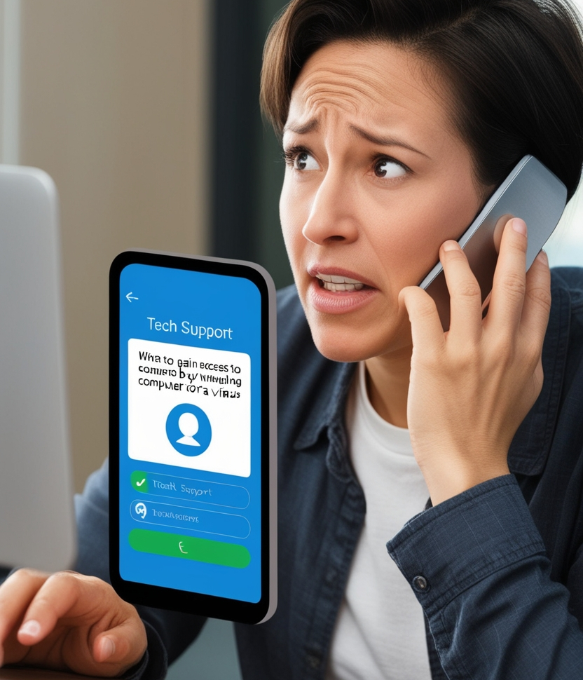
Vishing
As an example for this phishing type, imagine that we receive a phone call from someone claiming to be tech support, saying our computer is infected with a virus. They ask us to provide access to your computer, allowing them to steal your data.

Slide 12
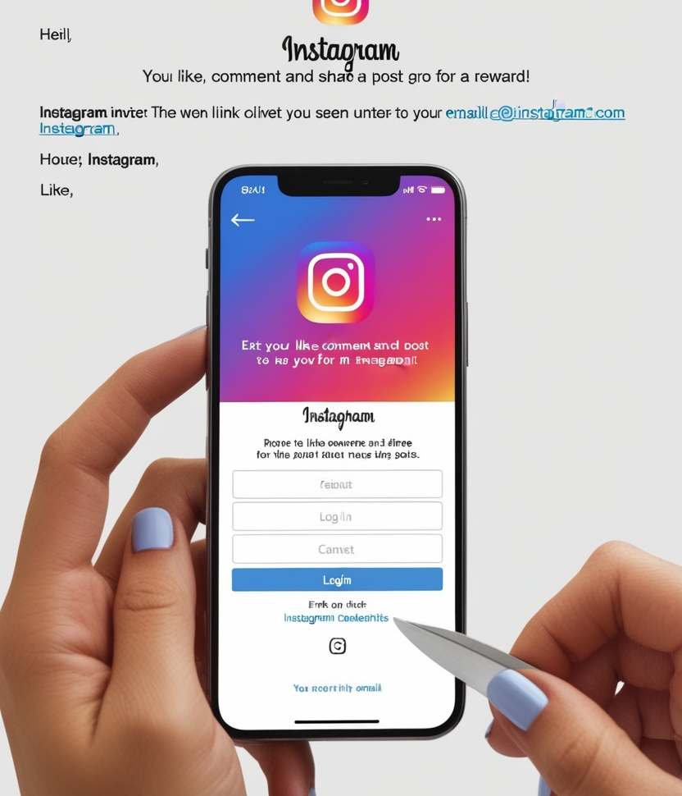
Angler Phishing
As an example for this phishing type, imagine that a phishing email pretending to be from Instagram invites the user to click a link to like a post for a reward. When clicked, the link directs to a fake Instagram login page that looks legitimate. The user, believing it’s real, is prompted to enter their Instagram credentials, then stolen by the attackers.

Slide 13
How Phishing Works
Social Engineering: Exploit trust through manipulation.
Impersonation: Pretend to be legitimate entities.
Fake Websites: Direct users to realistic-looking fake sites to steal login credentials.
Malicious Attachments: Contain malware that compromises the user’s device.

Slide 14
Common Signs of Phishing Emails
Suspicious Sender Addresses: Random or slightly altered domain names.
Urgent or Alarming Language: Creates a sense of urgency.
Unusual Links or Attachments: Unfamiliar formats or prompts.
Grammatical Errors: Often contains spelling and grammar mistakes.

Slide 15
Consequences of Falling for Phishing
Identity Theft: Stolen personal information leads to identity misuse.
Financial Losses: Loss of money due to fraudulent transactions.
Data Breaches: Sensitive corporate or personal data being exposed.

Slide 16
How to Protect ourself from Phishing
Verify the Source: Double-check email addresses and links.
Two-Factor Authentication (2FA): Adds extra security to logins.
Antivirus Software: Prevents malicious downloads from phishing emails.
Update Software: Patch vulnerabilities attackers may exploit.

Slide 17
Study more on phishing attacks to identify its functionality
Most of the time, Hackers or Malicious Actors use operating systems like Kali Linux or Parrot OS to implement attacks.
As common tools we can mention Shellphish and Zphisher.
Tools like above help to clone phishing sites similar to the popular social media platforms or essential services platforms.
Hackers can easily share the links of the clone sites to their targets.
Those phishing sites looks legitimate and appeared to be as the original platforms. Thereby users directed to enter their credentials or sensitive information.

Slide 18
FINDINGS FROM EXPLORATION
We need to think like a thief to protect ourselves from a thief. Likewise, we need to think like a hacker to protect ourselves within this cyber world.
According to the exploration, the only main way to identify a phishing site is to check the site’s URL twice.
As an example, imagine a site directed from a link sent by an unknown sender in Email, appeared to be an Instagram login page. We can check the URL twice. If it is original Instagram login page, the URL should be like https://www.instagram.com/accounts/login/. If it is not, it may be a phishing site.

Slide 19
REAL WORLD
PHISHING ATTACK SCENARIOS

Slide 20
Google and Facebook Scandal
Example: In 2017, employees at Google and Facebook were tricked into transferring $100 million to fraudulent accounts through a phishing scam that posed as a legitimate business partner.
Lesson: Phishing can fool even tech giants, proving the importance of strong verification processes and employee training.

Slide 21
Target Data Breach
Example: In 2013, a phishing email led to a major breach at Target, exposing the credit card information of over 40 million customers. The breach started with phishing emails sent to third-party vendors.
Lesson: Phishing can have devastating consequences when supply chains are compromised.

Slide 22
COVID-19 Pandemic Scams
Example: During the pandemic, attackers sent fake emails pretending to offer COVID-19 relief funds or health updates. Many fell for these phishing scams, revealing personal and financial details.
Lesson: Crisis situations like global pandemics are exploited by cybercriminals to launch phishing attacks.

Slide 23
Sony Pictures Hack
Example: In 2014, Sony Pictures suffered a major hack after employees fell for a phishing email, leaking confidential company information and causing significant financial loss.
Lesson: Phishing attacks can lead to massive breaches of sensitive data and irreparable damage to reputation.

Slide 24
CONCLUSION
Phishing awareness is crucial for safeguarding personal and organizational data from cyber threats. By staying informed, recognizing phishing signs, and reporting suspicious activity, we can protect ourselves and others. Always be cautious before clicking links or sharing sensitive information.

Slide 25
THANK YOU
Name: Chandu Dissanayake
Student ID: CA/S3/6378
wmchandu2005c@gmail.com
Cyber Security Domain

